Slide 1
Adversaries in a Sector
Objective: transmit to a receiver and avoid a certain sector nearby
In this example, the receiver is located at 12 degrees and the adversaries are within 30 to 60 degrees.
10 sample adversaries from this sector which are treated as pseudo nulls. The target null/beam ratio is set at 0.2.
IPG without feedback, treating it like a beam and null forming problem
tested with simulated Rayleigh fading in the channels.

Slide 2
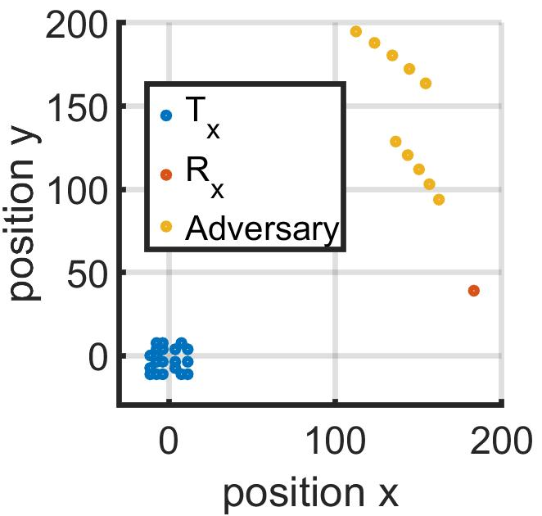
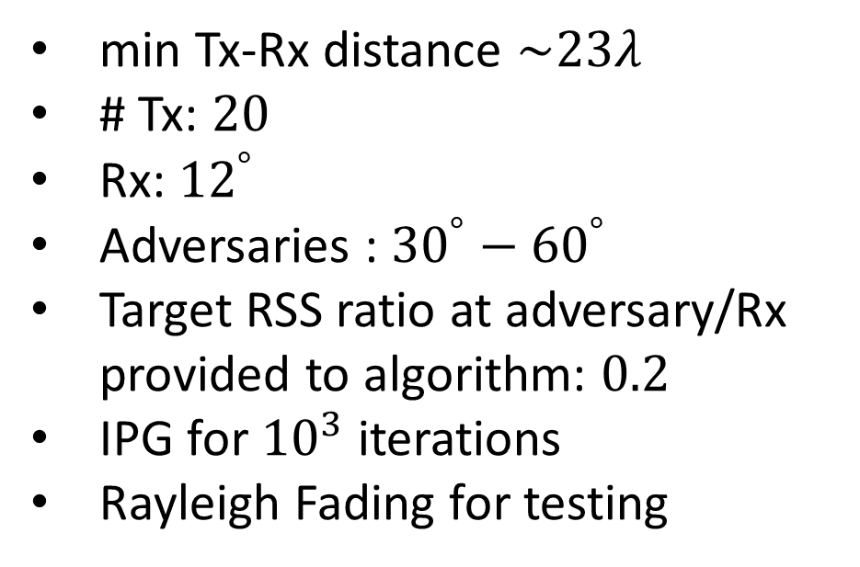
Specification of the Example
min Tx-Rx distance $\sim 23λ$
# Tx: $20$
Rx: ${12}^{°}$
Adversaries : ${30}^{°}−{60}^{°}$
Target RSS ratio at adversary/Rx provided to algorithm: $0.2$
IPG for ${10}^{3}$ iterations
Rayleigh Fading for testing

Slide 3
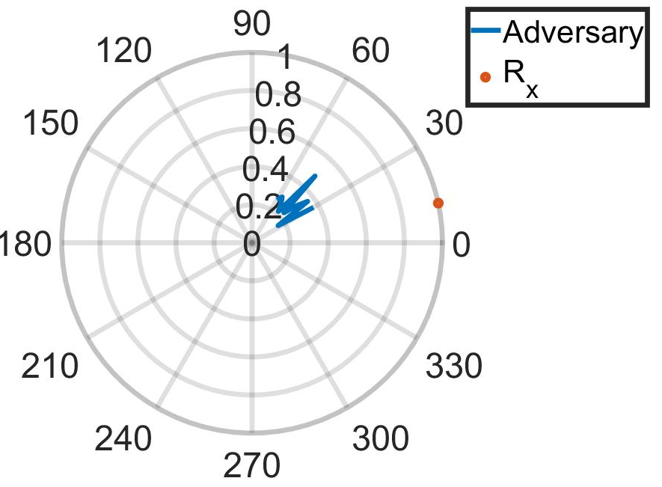
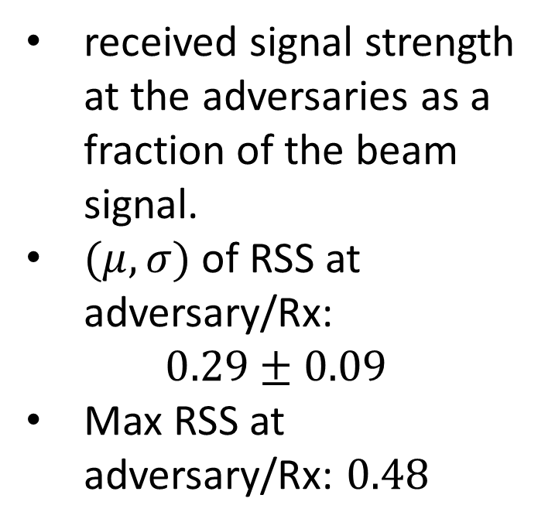
RSS Ratio at Adversary/Rx
received signal strength at the adversaries as a fraction of the beam signal.
$(μ,σ)$ of RSS at adversary/Rx:
$$0.29±0.09$$
Max RSS at adversary/Rx: $0.48$

